Slide 1

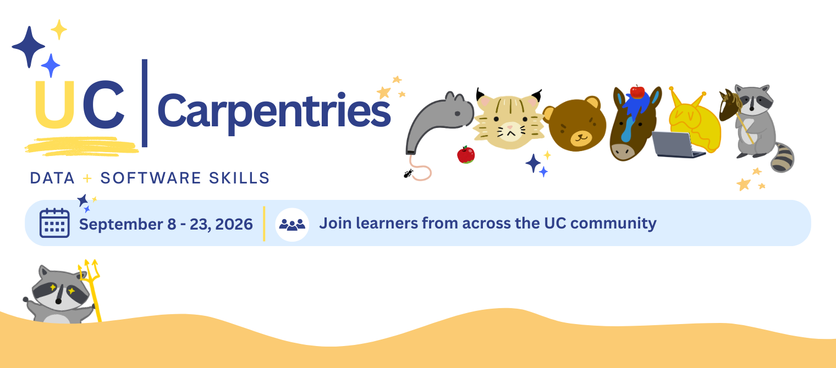

UC CARPENTRIES WORKSHOP SERIES · FALL 2026
Welcome!
We'll begin shortly. Grab the collaborative notes and settle in.
www.tim-dennis.com/2026-09-08-uc-carpentries

Slide 2

HOW WE LEARN TOGETHER
OUR PEDAGOGY
MANAGING EXPECTATIONS
▪
Live Coding: We learn by doing together; mistakes are pedagogical opportunities.
▪
Practical Competence: Skills you can apply immediately in your library role.
▪
Mental Models: Building understanding by connecting new skills to your daily work.
▪
Collaborative Pace: We move as a group; your questions help set the speed.
▪
No Overload: We focus on a few key concepts to ensure mastery over speed.
▪
Mistakes are Expected: Coding is a process of troubleshooting and persistence.

Slide 3
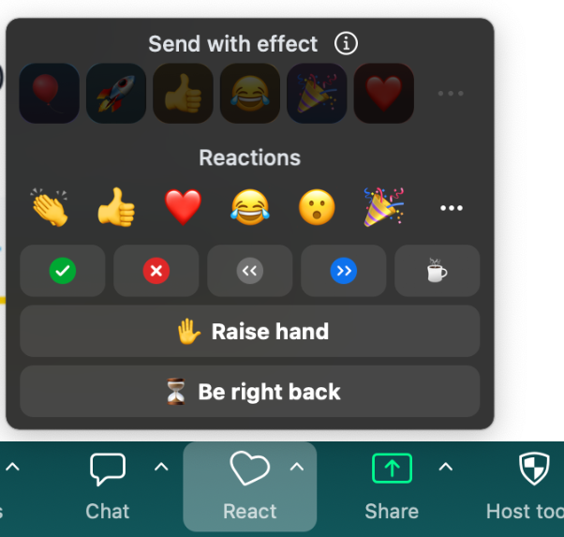
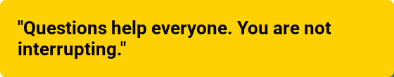

ZOOM TOOLS & SUPPORT
ZOOM ETIQUETTE
Raise Hand for verbal questions
Use Chat for technical issues & help
Use Non-verbal icons (Yes/No/Speed)
COMMUNICATION
Post questions in Etherpad shared notes
Helpers monitor chat for immediate aid
Typing "I'm stuck" is a complete sentence

